Slide 1
Technical overview LoRaWAN network Professor: Dr.Mehdi Rasti Lecturer: Jaber Babaki Amirkabir University of Technology Spring 2021

Slide 2

HELLO!
I AM JABER BABAKI
You can find me at:
Email: jaber.babaki@gmail.com
GitHub: https://github.com/JaberBabaki
Linkedin: https://www.linkedin.com/in/jaber-babaki-9b5474102/
Telegram: @jaberALU

Slide 3
Agenda
1- Big concept
2- Communication technologies
3- LoRaWAN Network
4- CSS modulation
5- RF Factor
6- ALOHA
7- LoRaWAN performance
IoT definition
IoT architecture
Technical research challenges
Defination Communication technologies
Long Range criteria
Compare Long Rage technologies
Protocol stack
LoRaWAN architrcture
End to End communication
Chrip signal
Spread factor
Symbol rate
Link budget
Receiving sensitivity
SNR
Maximum daily packets on LoRaWAN
Defination ALOHA
Analysis ALOHA
Maximum throughput
Maximum Number

Slide 4
BIG CONCEPT
1
Let’s start with big concept about "Internet of Thing" and "Long Range Wide Area Network"

Slide 5
Introduction
The Internet of Things (IoT) is an extension of the Internet in which large numbers of “things”, including sensors, actuators and processors, in addition to human users, are networked and able to provide high resolution data on their environment and exercise a degree of control over it[1].
The principal advantage of IoT consists of its ability to enable communication between an infinite amount of machines incorporated into a large-scale wireless network[1].
These automated devices and sensors together produce and transmit information in real-time, which is useless in the case of incorrect or insufficient filtering and data processing[1].

Slide 6

Introduction
Cloud Server
IoT Edge Device
IoT Sensor
IoT Gateway/
Framework
Stream Processing
User
Interface
Bulk Device Provisioning
etc.,
Data Transformation
Reporting
Tools
Machine
Learning
User
Management
Things
Insights
Action
Figure 1: Abstract architectures[2].

Slide 7








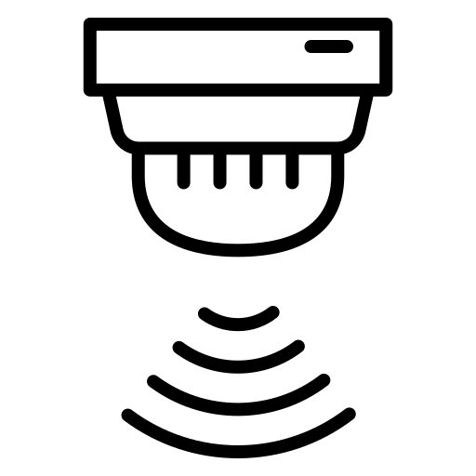
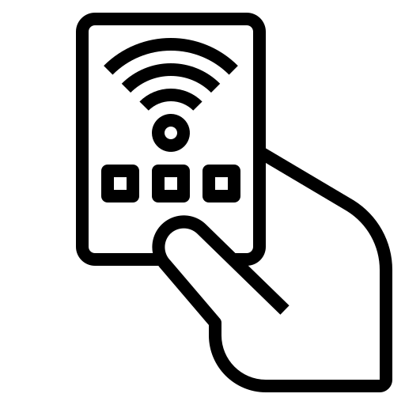
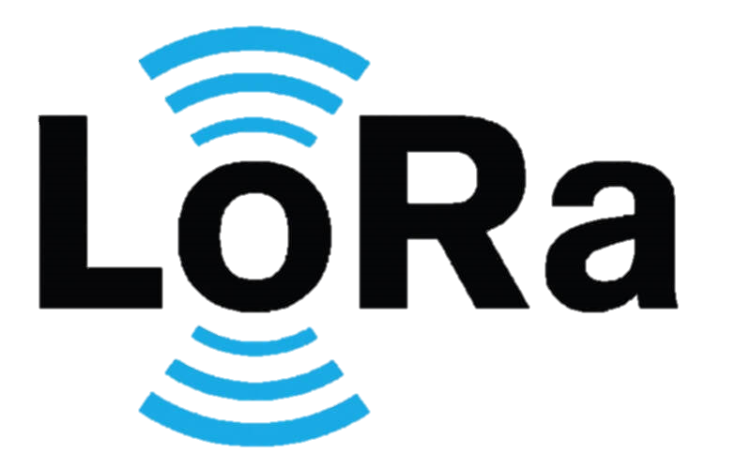









Introduction
IoT
Sensors
Interfaces
BLE
Physical Layer
MAC Layer
Cellular
4G/ 5G
Internet
Cloud Server
RFID
PCB
and
Micro
Processor
Eavesdropping
impersonation and interrogation attacks
Battery drainage
collision attack
Serial Port
LoRa
Gateway
Optical
IoT
Devices
Hardware failure
exploitation of CSMA
Malicious data injection
IoT
Gateway
Fragmentation attack
Sybil attack
replay attacks
IP Camera
Low Power
Ethernet
Edge
Computing
Node
Figure 2: Network-centric view.

Slide 8
Introduction
IoT NFV SDN network slicing blockchain traffic offloading cloud
Blockchain
5G Core
Cloud/fog Computing
Traffic offloading
NFV
network slicing
SDN
Figure 2: Network-centric view.

Slide 9


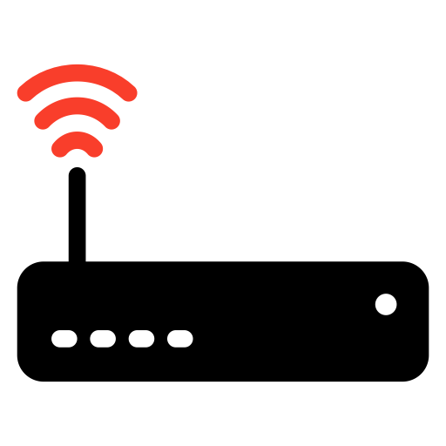



Introduction
IoT NFV SDN network slicing blockchain traffic offloading cloud
OSS/BSS
IoT Slice Orchestrator
Network Slicing Orchestrator
Network
Domain
Ran Orchestrator
Transport Network
Orchestrator
Core Network
Orchestrator
Computing and Storage Domains
Edge Computing Orchestrator
Cloud Computing Orchestrator
Central Office
Mini DC
Central Office
Date Center
Radio Access Network
Core Network
Transport Network
Central Office
Date Center
Date Center
Central Office
Device Fog
Network Edge
Cloud

Slide 10
Introduction
Stream Ingestion
Data Dashboard
Logging and Security
Visualization
API Management
HTTP
IoT
Platform
Notification Hub
MQTT
Train
Cloud Infrastructure
Web portal
Analyzing Lay
Account Manager
Plugins Manager

Slide 11
Introduction
Many of these are technical, including interoperability and scalability
How to invest in the IoT is a challenge for business
Major social, legal and ethical challenges, including security and privacy
As the future IoT will be a multi-national, multi-industry, multi-technology infrastructure
[1] Peter J. Ryan 1 and Richard B. Watson, “Research Challenges for the Internet of Things: What Role Can OR Play?”, systems journal, 14 March 2017 .

Slide 12
The main IoT technical research challenges
Design
Architecture
Interoperability
Scalability
Mobility
Security and Privacy
Scientific/Engineering
Energy efficiency/ Power
Reliability /Robustness
Management/ Operation
Software
Development
Availability
Data management
Cloud computing
[1] Peter J. Ryan 1 and Richard B. Watson, “Research Challenges for the Internet of Things: What Role Can OR Play?”, systems journal, 14 March 2017 .

Slide 13
Operation research (OP)
Operation research (OP): the field of OP is an applied discipline which aims to help solve real. It includes many mathematical tools and techniques
OR can support the design management and use of Internet of thing (IoT) which type of new technology which promise to change the world.

Slide 14
Operation research (OP)
Data Analytic/Database: Data Analytics is the science of studying data to draw conclusions. With billions or even trillions of device connected to the IoT, There will be vast amounts of data including identification, positional, environmental, historical, and descriptive data.
Game theory: Is a method of understanding interactions among groups in conflict with each other. Each side can choose between several actions with the outcome dependent on the actions taken by all players.

Slide 15
Operation research (OP)
Simulation: Discrete-event simulation simulates the operation of a system as a discrete sequence of events with each event marking a change of state of the system. Between events, no change in the system state is assumed. Discrete-event simulation can be applied to the study of issues in IoT networks.
Fuzzy Systems Theory: Fuzzy systems use fuzzy logic where input variables can take on continuous values, in contrast to digital systems that operate on discrete values. Fuzzy information algorithm using multi-criteria decision analysis and applied it to spacecraft landing safety.

Slide 16
Operation research (OP)
Artificial Intelligence: The applications of artificial intelligence (AI) and machine learning (ML) technologies in wireless communications have drawn significant attention recently. AI techniques have become an enabler in wireless communications to fulfill the increasing and diverse requirements across a large range of application scenarios.
Queuing Theory: Queuing theory is the mathematical study of queues.. Queuing Theory is an ideal tool for studying behavior of computer networks where the messages (packets) are the customers and the service is the assignment of the messages to communication links [61]. Queuing Theory can help determine network response and throughput by making assumptions about message distribution and node response.

Slide 17
Operation research (OP)
Graph Theory: Graph theory uses geometric structures (graphs) to model relations between objects. It was invented in the 1700s to solve the Konigsberg Bridge Problem by the famous Swiss mathematician Leonard Euler [63].
Optimization approaches: mathematical programming is the selection of a best element (with regard to some criterion) from some set of available alternatives. Optimization problems of sorts arise in all quantitative disciplines from computer science and engineering to operations research, and the development of solution methods has been of interest in mathematics for centuries

Slide 18
Communication technologies
2

Slide 19
Communication and transport technologies
An essential requirement for implementing a large and cooperating network of devices is the ability to have a flexible, inexpensive and adaptive connectivity layer.
For these reasons, during the years, several wireless connectivity standards have emerged, ranging from very short-range, low power connections to long-range connectivity solutions based on cellular technologies.
While short-range protocols can be successfully used for a number of applications (e.g., smart homes, wearable, etc.), for many other applications larger coverage radii become mandatory.
[3] LPWAN white paper, Leverege LLC, 2020 | www.leverege.com

Slide 20
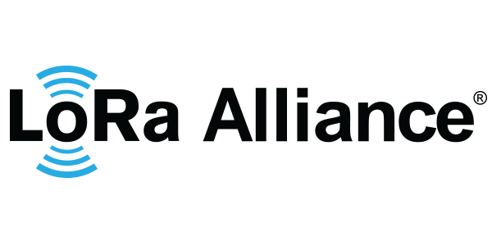



Communication and transport technologies
We expect that in 2024 more than the 40% of the wide area M2M connections will be LPWAN. That is why several companies are developing different protocols to implement the LPWAN technology.
[3] LPWAN white paper, Leverege LLC, 2020 | www.leverege.com

Slide 21
Communication and transport technologies
To compare the protocols we keep in mind some of the most important characteristics of the LPWAN and some others important features like:
Range: We all know that the range of any wireless technology can vary based on what is in the way of the signal. A dense urban setting, with walls, buildings, reflections, lots of other people and traffic, means much shorter range than a rural one. And a at, unobstructed rural setting will behave better than a hilly one.
Band and spectrum: As we have explained there are protocols that use the free ISM band and others that use licensed spectrum. We can see also differences into the spectrum use, there are some protocols that use Ultra Narrow Band, some are Narrow Band, and some others like LoRa uses Spread Spectrum (Chirp Spread Spectrum).
[3] LPWAN white paper, Leverege LLC, 2020 | www.leverege.com

Slide 22
Communication and transport technologies
Data Rate: This is another highly variable parameter, it can depend on the distance to the receptor, the obstructions...
Over-the-air updates: This may sound like a random characteristic, but it can be important depending on the application and the deployment of the end-devices. When the number of end-devices is hight or the devices are placed on a remote place, we will get greats advantages of this feature.
Handover: IoT has an extensive application fields, we will find applications where the end-devices will be static units, in other cases they will be mobile (vehicles in urban or rural areas, for farm implementations for example). So it is natural to wonder whether a protocol that can handle the hand-off a device as it moves between hubs, this matters only to the extent that a "session" of some sort is being maintained.
[3] LPWAN white paper, Leverege LLC, 2020 | www.leverege.com

Slide 23
Communication and transport technologies
 | LoRa | SIGFOX | Telensa | ingenu
Range [km] | 3-8 urban 15-20 suburban | 3-10 urban 30-50 suburban | Up to 8 | 4
Band | Sub-GHz | Sub-GHz | Sub-GHz | 2.4 GHz
Modulation | Spread Spectrum | Ultra-Narrow Band | Ultra-Narrow Band | Spread Spectrum
Data Rate [kbps] | 0.3-22 | 0.1-0.6 | low | 20
OTA upgrades | Yes | No | Yes | Yes
Handover | No | Yes | Yes | Yes
Table 1: A Comparison of LPWAN Technologies [3].

Slide 24
LoRaWAN Network
3

Slide 25



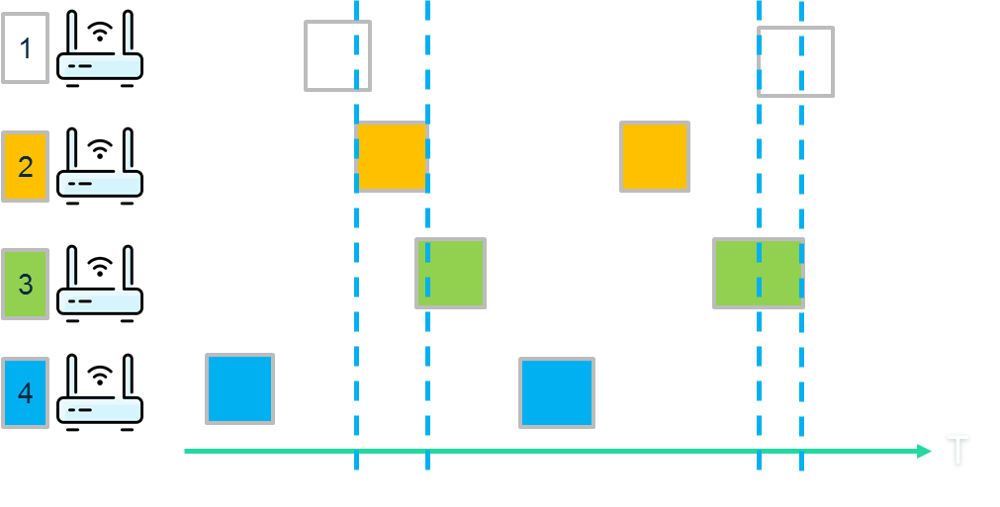
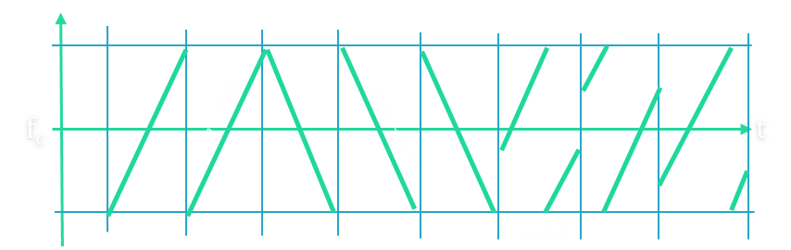
LoRaWAN network
The LoRaWAN network is formed by two core components: LoRa and LoRaWAN, each of which refers to a layer in the protocol stack. LoRa is a physical layer modulation developed by Semtech. LoRaWAN is implemented on top of the LoRa and includes data link and network layers [4].
Application
Application layer
LoRa MAC
MAC options
MAC layer (LoRaWAN)
Class A
Class B
Class C
LoRa Modulation
Regional ISM band
PHY layer (LoRa)
EU 868 [MHz]
EU 433 [MHz]
US 915 [MHz]
AS 430[MHz]
-----
Figure 2: protocol stack.

Slide 26
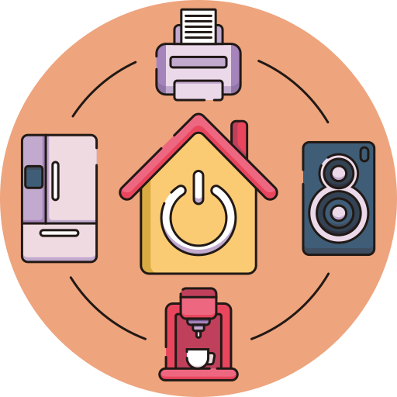



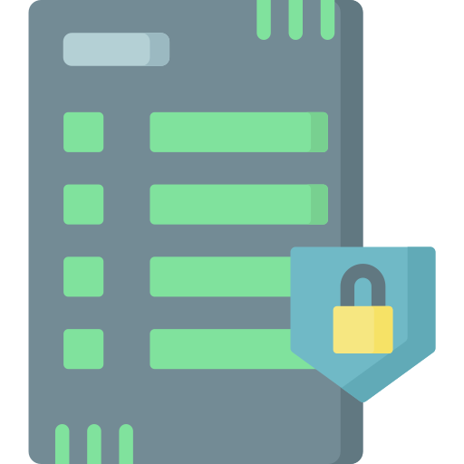

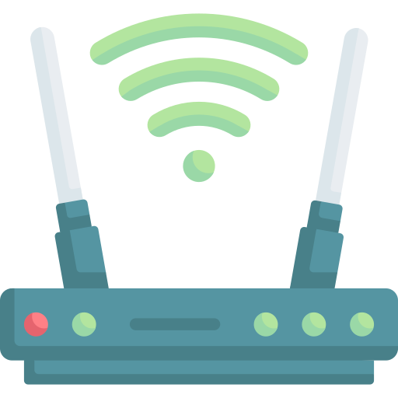
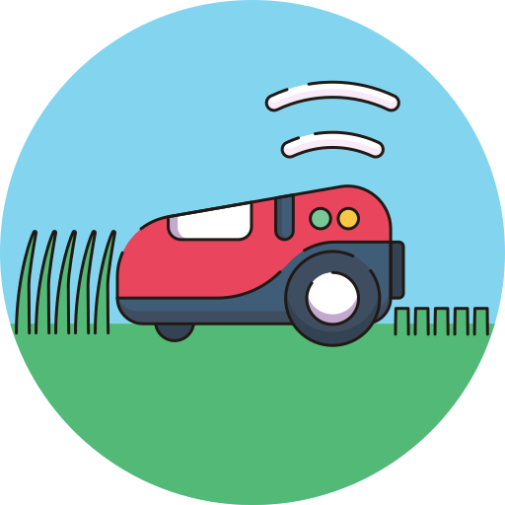
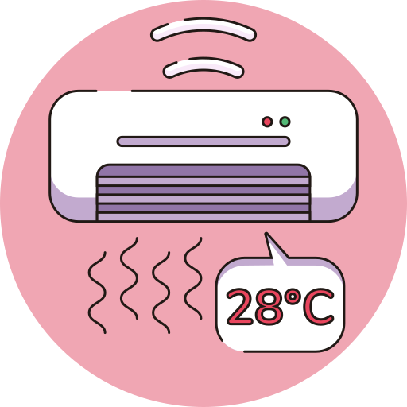
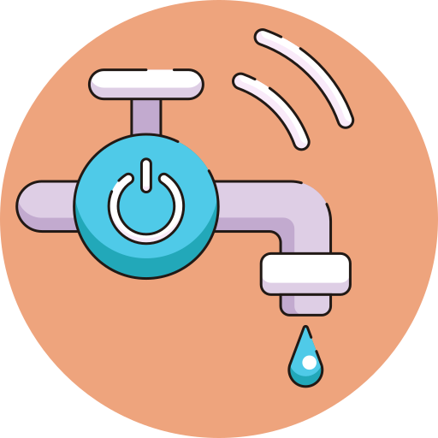
LoRaWAN network
As seen in this figure, the nodes send data to the platform through the gateways. Note that the nodes are not assigned to a specific gateway. Rather, all the gateways in the transmission range of a node receive its data and send it to the platform.
Application Server
Network Server
G2
4G/Ethernet/WiFi
G3
G1
Figure 3: LoRaWAN architecture.

Slide 27
LoRaWAN network
The gateways are connected to the network server via standard IP connections and act as a transparent bridge, simply converting RF packets to IP packets and vice versa.
Node
Network Server
Customer Application
Processor
Encrypted
Customer Server
Encrypted
LoRaWAN Master
LoRaWAN Master
Packet Forward
HAL
HAL
BackhaulIP Stack
BackhaulIP Stack
SPI
SPI
Ethernet, 4G, WiFi
PHY
LoRa
PHY
Gateway host
Figure 4: End-to-End communication[5].

Slide 28
CSS as a modulation for Long Range
4

Slide 29
Technical overview CSS as a modulation for Long Range Communication
Long range low power is a family of technologies promising to connect thousands of sensors to the future internet of things. Within this family of possible technology choices, two different branches have emerged
Spread wideband communication
Narrowband communication
[6] V. Talla, M. Hessar, B. Kellogg, A. Najafi, J. R. Smith, S. Gollakota, “LoRa Backscer: EnabalingThe Vision of Ubiquitous Connectivity”, Proceedings of the ACM on Interactive, Mobile, Wearable and Ubiquitous Technologies, 2017/9/11.

Slide 30





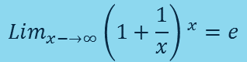




Technical overview CSS as a modulation for Long Range Communication
In information theory, the Shannon-Hartley theorem states the maximum rate at which information can be transmitted over a communications channel of a specified bandwidth in the presence of noise.
$$C_{∞}=\frac{S}{N_{0}}×{Log(e)}^{ }=\frac{S}{N_{0}}×1.44$$
$$C=B×Log(1+\frac{S}{N})$$
$$C = channel capacity [bps]. \\ B = channel bandwidth [Hz].$$
$$N = average noise or interference power \left[W\right].$$
$$S = average received signal power [W].$$
To reach this limit only the transmitted signal bandwidth needs be increased. This characteristic is the basic principle of Spread Spectrum as we see on next section.
If the noise is white noise, then the total noise power N in a bandwidth B is
$$B ×N_{0}$$
$$C=B×Log(1+\frac{S}{B×N_{0}})$$
$$C=(\frac{S}{N_{0}})×\frac{N_{0}×B}{S}Log(1+\frac{S}{B×N_{0}})$$
$$Lim_{x−→∞}{\left(1+\frac{1}{x}\right) }^{x}=e$$
$$C=(\frac{S}{N_{0}})×{Log(1+\frac{S}{B×N_{0}})}^{(\frac{N_{0}×B}{S})}$$
$$C_{∞}=\frac{S}{N_{0}}×{Log(e)}^{ }=\frac{S}{N_{0}}×1.44$$
[6] V. Talla, M. Hessar, B. Kellogg, A. Najafi, J. R. Smith, S. Gollakota, “LoRa Backscer: EnabalingThe Vision of Ubiquitous Connectivity”, Proceedings of the ACM on Interactive, Mobile, Wearable and Ubiquitous Technologies, 2017/9/11.

Slide 31


Technical overview CSS as a modulation for Long Range Communication
Band of signals occupy a narrow/wide range of frequencies
Power density is high/very low(max power SigFox and LoRa equal 20dBm).
Frequency-hopping spread spectrum (FHSS)
Direct-sequence spread spectrum (DSSS)
Time-hopping spread spectrum (THSS)
Chirp spread spectrum (CSS)
$$\frac{S}{N_{0}}.X (In terms of bandwidth)$$
Power
Narrowband
Noise
Spread spectrum
Frequency
[6] V. Talla, M. Hessar, B. Kellogg, A. Najafi, J. R. Smith, S. Gollakota, “LoRa Backscaer: Enabling The Vision of Ubiquitous Connectivity”, Proceedings of the ACM on Interactive, Mobile, Wearable and Ubiquitous Technologies, 2017/9/11.

Slide 32
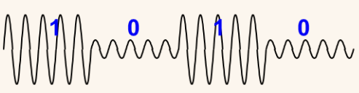

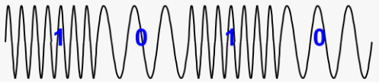
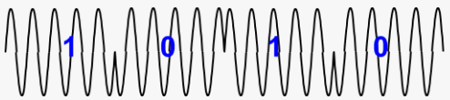




Technical overview CSS as a modulation for Long Range Communication
$$A$$
$$A$$
$$A$$
$$1$$
$$0$$
$$1$$
$$T$$
$$T$$
$$T$$
$$s\left(t\right)=A sin⁡(2πf_{c}t+∅)$$
$$ASK$$
$$A$$
System
Input Message
Channel Encoder
Modulator
$$T$$
$$FSK$$
$$A$$
$$T$$
$$PSK$$
[6] V. Talla, M. Hessar, B. Kellogg, A. Najafi, J. R. Smith, S. Gollakota, “LoRa Backscaer: Enabling The Vision of Ubiquitous Connectivity”, Proceedings of the ACM on Interactive, Mobile, Wearable and Ubiquitous Technologies, 2017/9/11.

Slide 33
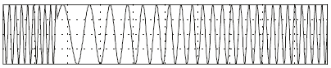




Technical overview CSS as a modulation for Long Range Communication
$$A$$
$$A$$
$$A$$
$$1$$
$$0$$
$$1$$
$$T$$
$$T$$
$$s\left(t\right)=A e^{i(2πf_{c}t+∅)}$$
LoRa Node
Input Message
Channel Encoder
Modulator
$$T$$
$$F$$
Spreading Generator
T
$$T$$
[6] V. Talla, M. Hessar, B. Kellogg, A. Najafi, J. R. Smith, S. Gollakota, “LoRa Backscaer: Enabling The Vision of Ubiquitous Connectivity”, Proceedings of the ACM on Interactive, Mobile, Wearable and Ubiquitous Technologies, 2017/9/11.

Slide 34




Technical overview CSS as a modulation for Long Range Communication
$$\frac{+BW}{2}$$
f_{c}
$$up−chrip$$
$$down−chrip$$
t
$$\frac{−BW}{2}$$
$$Symbol$$
[6] V. Talla, M. Hessar, B. Kellogg, A. Najafi, J. R. Smith, S. Gollakota, “LoRa Backscaer: Enabling The Vision of Ubiquitous Connectivity”, Proceedings of the ACM on Interactive, Mobile, Wearable and Ubiquitous Technologies, 2017/9/11.

Slide 35









Technical overview CSS as a modulation for Long Range Communication
The spreading factor, SF , is the number of bits encoded in each chirp duration.
$$SF=2$$
$$\frac{+BW}{2}$$
$$00$$
$0$1
$$11$$
$$10$$
$$SF=2$$
$$SF=sf$$
f₃
$$N=2^{2} sample$$
$$N=2^{sf} sample$$
f₂
f_{c}
t
f₁
$$chrip symbol= \log_{2}{4}$$
$$chrip symbol= \log_{2}{N}$$
f₀
f$requencies=f_{0}….f_{3}$
f$requencies=2^{sf}$
$$\frac{−BW}{2}$$
[6] V. Talla, M. Hessar, B. Kellogg, A. Najafi, J. R. Smith, S. Gollakota, “LoRa Backscaer: Enabling The Vision of Ubiquitous Connectivity”, Proceedings of the ACM on Interactive, Mobile, Wearable and Ubiquitous Technologies, 2017/9/11.

Slide 36
















Technical overview CSS as a modulation for Long Range Communication
$$SF=7 BW=125kHz$$
$$SF=8 BW=125kHz$$
$$SF=8 BW=250kHz$$
$$f_{3}$$
$$f_{2}$$
$$f_{2}$$
$$f_{2}$$
t
t
t
$$f_{1}$$
$$f_{1}$$
$$f_{1}$$
$$f_{4}$$
$$symbol time(s)=\frac{2^{sf}}{BW}$$
$$SF=sf$$
$$CR?$$
$$N=2^{sf} sample$$
$$energy consumption?$$
$$symbol rate(s)=\frac{BW}{2^{sf}}$$
$$chrip symbol= \log_{2}{N}$$
$$PSS=symbol time × E_{sf}$$
$$bit rate(s)=\frac{BW}{2^{sf}}sf$$
f$requencies=2^{sf}$
[6] V. Talla, M. Hessar, B. Kellogg, A. Najafi, J. R. Smith, S. Gollakota, “LoRa Backscaer: Enabling The Vision of Ubiquitous Connectivity”, Proceedings of the ACM on Interactive, Mobile, Wearable and Ubiquitous Technologies, 2017/9/11.

Slide 37
Factors determine RF range
5

Slide 38


Decibel
A unit of measurement is a definite magnitude of a quantity, defined and adopted by convention or by law, that is used as a standard for measurement of the same kind of quantity.
If a person is listening to a radio with a sound power of 10 watts, the volume will not be doubled when it increases the output power to 20 watts.
The decibel (symbol: dB) is a relative unit of measurement corresponding to one tenth of a bel (B). It is used to express the ratio of one value of a power or root-power quantity to another, on a logarithmic scale.
$$x_{dB}=10×\log_{10}\left(\frac{signal}{ref.signal}\right)$$
$$x_{dB}=10×\log_{10}\left(\frac{20}{10}\right)=3 dB of gain$$

Slide 39



Decibel
What if we want to measure an absolute power with dB? We have to define a reference.
The reference point that relates the logarithmic dB scale to the linear watt scale may be for example this:
$$1mW=0 dBm$$
The new m in dBm refers to the fact that the reference is one mW, and therefore a dBm measurement is a measurement of absolute power with reference to 1 mW.
To convert power in mW to dBm:
$$P_{dBm}=10×\log_{10}{P_{mW}}$$
To convert power in dBm to mW:
$$P_{mW}={10}^{\frac{P_{dBm}}{10}}$$
[11] WIRELESS NETWORKING IN THE DEVELOPING WORLD, http://wndw.net

Slide 40










Decibel
Example: mW to dBm, Radio signal power: 100mW
$$P_{dBm}=10×\log_{10}{(100)}$$
$$100mW=20dBm$$
Example: dBm to mW, Radio signal power: 17dBm
$$P_{mW}={10}^{\frac{17}{10}}$$
$$17dBm=50 mW$$
You can now imagine situations in which:
$$10 mW + 10 dB of gain = ?dBm, ?mW$$
$$10 dB=10×Log_{10}(\frac{x_{mW}}{10mW})$$
$$100 mW = 20 dBm$$
$$20 dBm − 10 dB of loss = ?dBm, ?mW$$
$$10 dBm = 10mW$$
$$50 mW + 3 dB = 100 mW = 20 dBm$$
$$17 dBm + 3 dB = 20 dBm = 100 mW$$
[11] WIRELESS NETWORKING IN THE DEVELOPING WORLD, http://wndw.net

Slide 41

What factors determine RF range and performance?
Link budget : The link budget is the difference between the strength of the transmitted signal and the minimum required signal at the receiver
Transmitter
Receiver
$$Link budget$$
$Link budget=TransmitPower(P_{t}) −Receiver Sensitivity(S_{r})$
$$−4$$
$$−3$$
$$−2$$
$$−1$$
$$0$$
$$1$$
$$2$$
$$3$$
$$For a typical LoRa radio:P_{t}=13 dBm, S_{r}=−137 dBm$$
$$Link budget=13−\left(−137\right)=150dBm$$
[7] LoRa™ Modulation Basics, SEMTECH

Slide 42







What factors determine RF range and performance?
ANT
ANT
Tx radio
Rx radio
cable
Path loss
cable
$$+20dBm$$
$$+10 dBi$$
$$−2dBm$$
$$Rx power or RSSI$$
$$−5dBm$$
$$+12 dBi$$
$$Powe(dBm)$$
$$−115 dBm$$
$$Link margin$$
$$S_{r} sensitivity$$
$$Distance$$
Figure 5: Example link budget calculation [8].

Slide 43
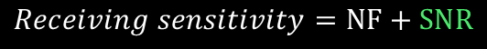

What factors determine RF range and performance?
SNR is key measure in wireless network.
In LoRa network SNR include Noise, SF, BW, TP, CR, Interference
Receiving sensitivity: refers to the smallest modulated signal that can be demodulated at the receiving end.
Tx power = 14 dBm
BW = 125KHz = 10log10(125000) = 51
NF = 6 dBm
SNR = -20 dBm(for SF=12)
Rx sensitivity = - 174 + 51 + 6 - 20 = -137 dBm
Link budget = 14dBm +(-137dBm )= 151dBm
Noise
$$Receiving sensitivity=NF+SNR$$
Power
Noise figure
$$−20dBm$$
LoRa
$$NF=−174+NF+10\log_{ }{BW}$$
Thermal noise for a 1 Hz bandwidth
Frequency
[7] LoRa™ Modulation Basics, SEMTECH

Slide 44
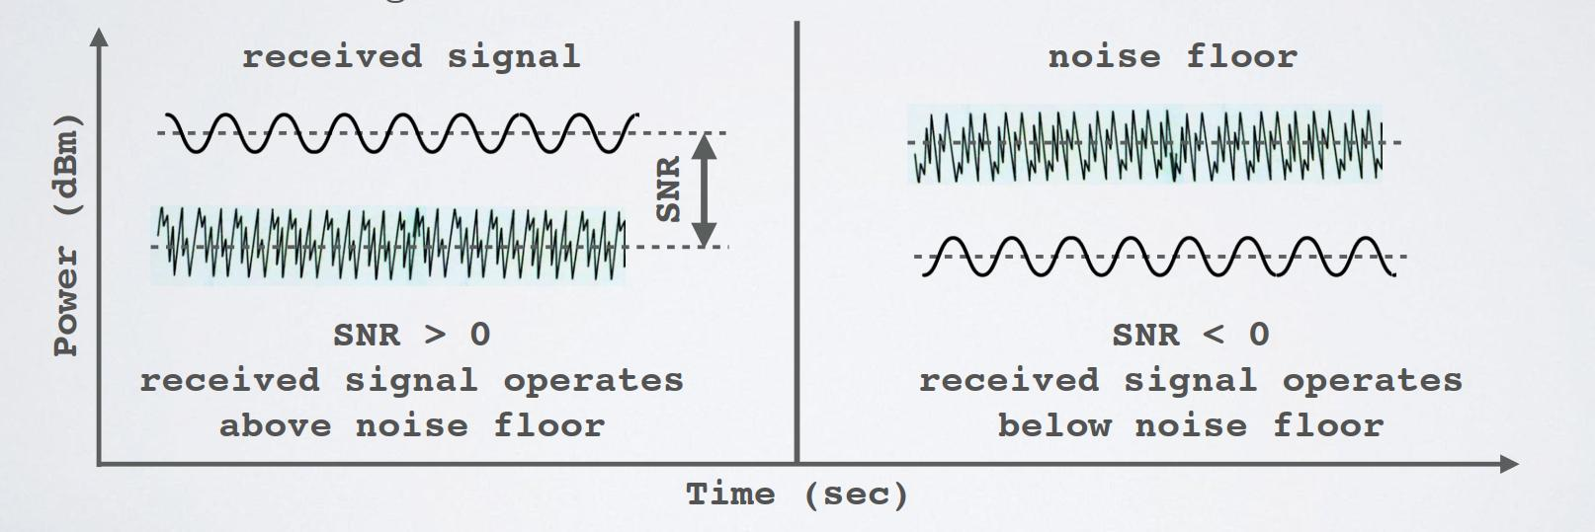
What factors determine RF range and performance?
Signal-to-Noise Ratio (SNR) : is the ratio between the received power signal and the noise floor power level.
Figure 6: Signal-to-Noise Ratio (SNR) [8].

Slide 45







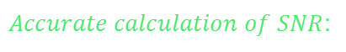






What factors determine RF range and performance?
$Accurate calculation of SNR$:
$$SNR=\frac{P_{s}}{P_{w}}$$
$$P_{s}=The average power of s(t)$$
$$P_{w}=The average power of noise$$
$$Calculate minimum SNR in terms of SF:$$
$$E_{bit}=RSSI×T_{bit}$$
$$SNR_{0}=\frac{E_{bit}}{NF}$$
$$SNR_{0}=\frac{RSSI×2^{SF}}{NF×BW}$$
$$T_{bit}=\frac{1}{BW}×2^{SF}$$
$$RSSI=\frac{SNR_{0}×NF×BW}{2^{SF}}$$
$$SNR(SF)=\frac{SNR_{0}}{2^{SF}}$$
$$SNR\left(12\right)=\frac{31}{2^{12}}=0.007mW=−21dBm$$
$$S_{r}=BW×NF×SNR(SF)$$
[9] T. Bouguera, J.F. Diouris , J.J Chaillout, R.Jaouadi, G. Andrieux, “Energy Consumption Model for Sensor Nodes Based on LoRa and LoRaWAN”, sensors, 30 June 2018.

Slide 46

What factors determine RF range and performance?
𝑃𝑎𝑡ℎ 𝑙𝑜𝑠𝑠 (PL): Path loss (or path attenuation) delineates a decline in power density of any given electromagnetic wave as it propagates through space.
Path loss models are developed using a combination of numerical methods and empirical approximations of measured data collected in channel sounding experiments.
In general, propagation path loss increases with frequency as well as distance:
$$L_{path}={(\frac{4.π.f}{c})}^{2}.d^{n }$$
$$d=distance \left(meter\right)$$
$$f=signal frequency \left(MHz\right)$$
$$n=is 2 for free space$$
$${L }_{path(dB)}={10Log_{10}((\frac{4×3.14×868}{300})}^{2}.{1000}^{2})= 91 dB$$
[9] T. Bouguera, J.F. Diouris , J.J Chaillout, R.Jaouadi, G. Andrieux, “Energy Consumption Model for Sensor Nodes Based on LoRa and LoRaWAN”, sensors, 30 June 2018.

Slide 47


What factors determine RF range and performance?
$$Calculate maximun distance in terms of SF:$$
$$d={\left(\frac{L_{path}}{{(\frac{4.π.f}{c})}^{2}}\right)}^{\frac{1}{n}}$$
$$We assume that there are no antenna gains and set the path loss L_{path} equal to L_{budget}$$
$$d={\left(\frac{L_{budget}}{{(\frac{4.π.f}{c})}^{2}}\right)}^{\frac{1}{n}}$$
[9] T. Bouguera, J.F. Diouris , J.J Chaillout, R.Jaouadi, G. Andrieux, “Energy Consumption Model for Sensor Nodes Based on LoRa and LoRaWAN”, sensors, 30 June 2018.

Slide 48
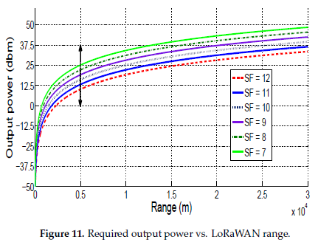
What factors determine RF range and performance?
[9] T. Bouguera, J.F. Diouris , J.J Chaillout, R.Jaouadi, G. Andrieux, “Energy Consumption Model for Sensor Nodes Based on LoRa and LoRaWAN”, sensors, 30 June 2018.

Slide 49




Maximum daily packets on LoRaWAN
Duration of the packet transmission
 | Description
SF | Spreading Factor
PL | Payload Length
CRC | The use of the Cyclic Redundancy Check (CRC, 1 when enabled 0 when not)
IH | The use of explicit header or not (IH, 1 when enabled 0 when not)
CR | Coding Rate
DE | The Low Data Rate Optimization (DE, 1 when used 0 when not).
$$T_{on_the_air}=T_{payload}+T_{preamble}$$
$$T_{preamble}=(4.25+N_{preamble}) ×T_{symbol }$$
$${N_{ }}_{preamble}=8$$
$$T_{payload}=N_{payload}×T_{symbol }$$
$$N_{payload}=8+max\left[Ceil\left(\frac{8PL−4SF+28+16−20IH}{4(SF−2DE)}\right)×(CR+4),0\right]$$
$$T_{symbol}=\frac{2^{SF}}{BW}$$
[10] E. Ruano, LoRaTM protocol Evaluations, limitations and practical test, May 11, 2016

Slide 50


Maximum daily packets on LoRaWAN
The time that the LoRa Mote has to wait before send the next packet is called T_{off}
$$T_{off}= {T_{on_the_air}×(}_{ }1− \frac{1}{DCycle})$$
So we can calculate the maximum daily packets
$$Daily packets=\frac{Seconds in a day}{T_{off}}$$
[10] E. Ruano, LoRaTM protocol Evaluations, limitations and practical test, May 11, 2016

Slide 51
Maximum daily packets on LoRaWAN
we can calculate theoretical T_{on-the-air} and maximum number of daily packets with variable payload, 8 symbols of preamble, CRC activated with a value of 4/5, Implicit Header deactivated, bandwidth of 125 kHz and Low Data Rate optimization activated for high spreading factors (SF11 and SF12).
 | 16B | 32B | 51B
7 | 60ms | 90ms | 110ms
8
9
10
11
12 | 161ms | 213ms | 276ms
 | 16B | 32B | 51B
7 | 13061 | 9657 | 7394
8
9
10
11
12 | 540 | 408 | 316
Table 2: Theoretical Time on-the-air and maximum number of daily packets [10].

Slide 52
What factors determine RF range and performance?
SF | 125 (kHz) |  |  | 250 (kHz) |  |  | 500 (kHz) |  |  | SNR (dBm) | Range (Km)
 | Bit rate (kb/s) | Sensitivity (dBm) | ToA (ms) | Bit rate (kb/s) | Sensitivity (dBm) | ToA (ms) | Bit rate (kb/s) | Sensitivity (dBm) | ToA (ms)
7 | 5.4 | -123 | 56 | 11 | -120 | 28 | 21.9 | -117 | 14 | -6.2 | 2
8
9
10
11
12 | 0.29 | -138 | 1155 | 0.5 | -135 | 577 | 1.17 | -132 | 288 | -21 | 15
Code rate: 4/5 Payload:14 byte

Slide 53
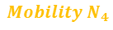


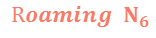
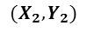

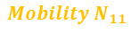
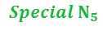
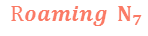
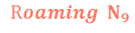
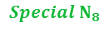
ADR
$$Roaming{ N}_{6}$$
$$SNR=\frac{power}{noise}$$
$$SF=?, PT=?$$
$$Special N_{5}$$
$$Mobility N_{11}$$
$$Roaming{ N}_{7}$$
$$SF=?, PT=?$$
$$d_{5}$$
$$d_{4}$$
$$SF=?, PT=?$$
$$(X_{2},Y_{2})$$
$$SF=?, PT=?$$
$$N_{1}$$
$$N_{2}$$
$$d_{1}$$
$$d_{2}$$
$$Special N_{8}$$
$$SF=12, PT=14$$
$$SF=7, PT=3$$
$$d_{3}$$
$$SF=?, PT=?$$
$$N_{3}$$
$$N_{10}$$
$$d_{4}$$
$$SF=11, PT=9$$
$$Roaming{ N}_{9}$$
$$SF=11, PT=9$$
$$Mobility N_{4}$$
$$SF=?, PT=?$$
$$SF=?, PT=?$$

Slide 54



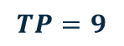

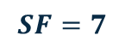

ADR
ADR-List
FrmCun | SNR | NumGat
1 | 7.5 | 3
10 | -10 | 2
… | -13.5 | 3
120 | 20 | 3
SNR, RSSI, Time,…
$$G1$$
Network Server
SNR, RSSI, Time,…
$$G2$$
SNR, RSSI, Time,…
Max(SNR)
$$G3$$
$$SF=7$$
$$TP=9$$

Slide 55

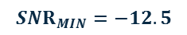


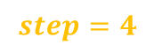



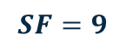


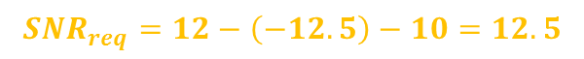
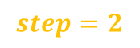



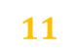


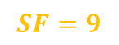

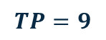

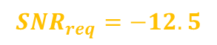




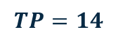

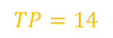
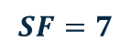

ADR
$$SF=9$$
$$TP=14$$
$$SNR_{MIN}=−12.5$$
$$SNR_{m}=10$$
$$\left.SNR_{m} ←max{(}SNR of last 20 frames\right)$$
$$\left.SNR_{req}←demodulation floor(current data rate\right)$$
$$SNR_{req}=−12.5$$
$$\left. SNR_{margin}←(SNR_{m}−SNR_{req}−10\right)$$
$$SNR_{req}=12−\left(−12.5\right)−10=12.5$$
$$\left. step←floor(SN{R_{margin}}/3\right)$$
$$step=4$$
$$while steps >0 and SF >SF_{min} do$$
$$step=4$$
$$3$$
$$2$$
$$SF←SF−1$$
$$SF=9$$
$$8$$
$$7$$
$$steps←steps−1$$
$$while steps >0 and TP >TP_{min} do$$
$$step=2$$
$$1$$
$$0$$
$$TP←TP−3$$
$$TP=14$$
$$11$$
$$9$$
$$steps←steps−1$$
$$while steps <0 and TP <TP_{max} do$$
$$SF=7$$
$$TP←TP+3$$
$$TP=9$$
$$steps←steps+1$$

Slide 56
ALOHA protocol
6

Slide 57

ALOHA protocol
System
Designated frequency
Input Message
Channel Encoder
Modulator
Channel
Output signal
Spreading Generator
Designated frequency
Channel
Output signal
Designated frequency
Channel
Output signal
.
.
[10] E. Ruano, LoRaTM protocol Evaluations, limitations and practical test, May 11, 2016

Slide 58

ALOHA protocol
TDMA creates channels by assigning users nonoverlapping time slots. In a system with N users, each user can thus use the total bandwidth W, but only a fraction 1/N of the time
1
$$peformance= \frac{10}{12}×100=83.3 \%$$
2
3
4
T
1
2
3
4
5
6
7
8
9
10
11
12

Slide 59
ALOHA protocol
Node transmits as soon as it has a frame.
If a collision is detected, it waits for a random time interval and then retransmits.
1
2
3
4
T

Slide 60









ALOHA protocol
Node transmits as soon as it has a frame.
If a collision is detected, it waits for a random time interval and then retransmits.
$$S_{out}=S_{in}$$
$$S_{out}=P_{succ}×G$$
packets generation rate per end-devices per time
packets rate send per end-devices per time on channel
$$λ$$
$$λ′$$
$$No, with P_{succ}$$
New packets
PHY
Channel
Collision?
$$S_{in}$$
MAC
$$G$$
Old packets
$$S_{out}$$
$$Yes, {with (1−P}_{succ})$$
Average packets generation rate per end-devices per time
Average packets send per end-devices per time on channel
[10] E. Ruano, LoRaTM protocol Evaluations, limitations and practical test, May 11, 2016

Slide 61








ALOHA protocol implemented on LoRaWAN
$$P[k occur in G time]=\frac{{G }^{k}}{k!}e^{−G}$$
$$Tx$$
$$S_{out}=Ge^{−2G}$$
$$T_{0}$$
$${T_{0}+ T}_{x}$$
$${T_{0}+2T}_{x}$$
$$P[k=0]=\frac{{G }^{0}}{0!}e^{−2G}$$
$$P[k=0]=e^{−2G}$$

Slide 62
ALOHA protocol

Slide 63





Slotted-ALOHA protocol
$$P[k occur in G time]=\frac{{G }^{k}}{k!}e^{−G}$$
1
$$Tx$$
2
$$T_{0}$$
$${T_{0}+ T}_{x}$$
3
$$P[k=0]=\frac{{G }^{0}}{0!}e^{−G}$$
4
$$T$$
$$S_{out−slotted}=Ge^{−G}$$

Slide 64
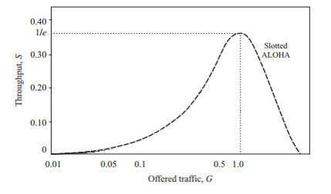
Slotted-ALOHA

Slide 65
ALOHA protocol implemented on LoRaWAN
7

Slide 66


ALOHA protocol implemented on LoRaWAN
λ represents all the packets sent to the network by all the LoRa devices in the same coverage area, so we can rewrite λ as:
$$λ=N.λ_{i}$$
$$λ_{i}=Represents the throughput of one device$$
$$N=The number of devices on the coverage area$$
Each packet sent by one LoRa device, will select randomly one channel from the 8 available, so the total throughput sent by one LoRa devices per channel will be:
$$λ_{i per channel}=\frac{λ_{i}}{8 channel}$$
[10] E. Ruano, LoRaTM protocol Evaluations, limitations and practical test, May 11, 2016

Slide 67

Maximum throughput per end-device and per channel
Considering packets of 16B payload, a bandwidth of 125 kHz and two available sub-bands on LoRaWAN (Band0 from 868.1 MHz to 868.5 MHz and Band1 from 867.1 MHz to 867.9 MHz).
 | Max. daily packets per end-device [packets/day] | Max. λ_{i} per end-device [packets/sec] | Max. λ _{i} _{per channel} [packets/sec]
SF7 | 26122 | 0,302 | 0,037
SF8
SF9
SF10
SF11
SF12 | 1080 | 0,012 | 0,001
$$Max. λi=\frac{26122}{86400}=0,302$$
Table 3: Theoretical Ton-the-air and maximum number of daily packets [10].

Slide 68






Maximum throughput per end-device and per channel
$$G=T_{tx}×λ$$
$$S\left(G=0.5\right)=18.4 \%$$
We can obtain the maximum number of end-devices in two different Scenario:
$$G_{SF7}=0.302×0.037=0.011174$$
$$G_{SF7}<0.5$$
$${0.5−G}_{SF7}=0.488826$$
Scenario 1: maximizing the packets send by the end-devices and throughput of network.
We can obtain the maximum number of end-devices N.
$$N=\frac{0.5}{T_{tx}×λ }$$
Scenario 2: considering 1 packet per end-device and per day.

Slide 69

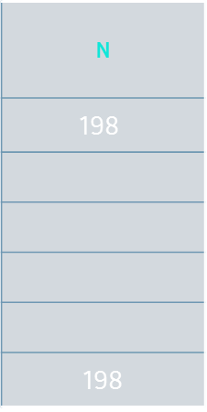
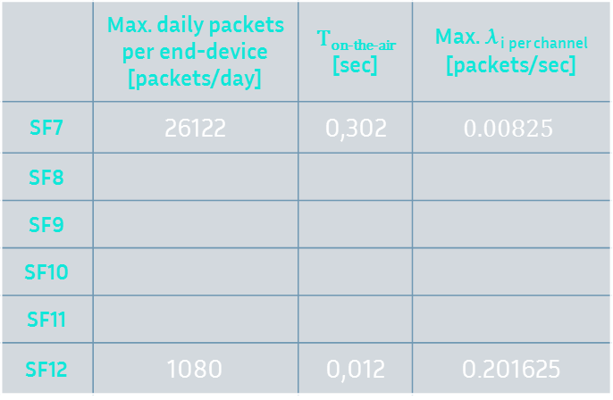


Maximum throughput per end-device and per channel Scenario 1
 | Max. daily packets per end-device [packets/day] | T_{on-the-air} [sec] | Max. λ _{i} _{per channel} [packets/sec]
SF7 | 26122 | 0,302 | $$0.00825$$
SF8
SF9
SF10
SF11
SF12 | 1080 | 0,012 | 0.201625
N
$$\text{198}$$
198
$$T_{tx_SF7_125kHz_16B}=0.066$$
$$λ_{i per channel}=\frac{0.066 }{8}=0.00825$$
$$N=\frac{0.5}{0,302 ×0.00825 }=198$$
Table 4: Theoretical Ton-the-air and maximum number of daily packets [10].

Slide 70

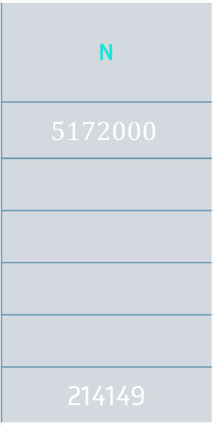
Maximum throughput per end-device and per channel Scenario 1
 | Max. daily packets per end-device [packets/day] | T_{on-the-air} [sec] | Max. λ _{i} _{per channel} [packets/sec]
SF7 | 1 | 0,066 | 0.00000144
SF8
SF9
SF10
SF11
SF12 | 1 | 1,613 | 0.00000144
N
$$5172000$$
214149
$$N=\frac{0.5}{0,066×0.00000144}=5172000$$
Table 5: Theoretical Ton-the-air and maximum number of daily packets [10].

Slide 71











Maximum throughput per end-device and per channel
$$5000000$$
$$SF=7$$
$$SF=12$$
$$8000$$
$$198$$
$$1$$
$$2000$$
$$8000$$
$$14000$$
$$26122$$
$$λ [packets/sec]$$
Figure 7: Maximum throughput per end-device and per channel [10].

Slide 72
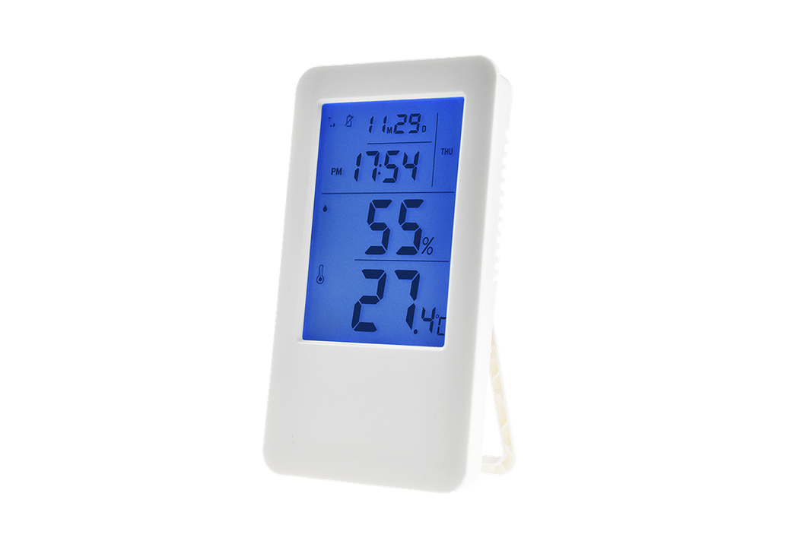
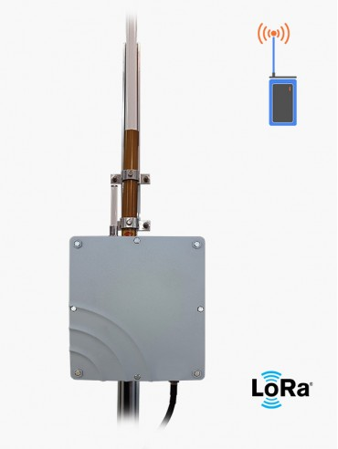






PCB design

Slide 73

PLATFORM
https://www.chirpstack.io/

Slide 74
We will continue
1- Delay Analyze
2- Interference Analyze
3- Energy consumption Analyze
4- Network model
6- Deep Analyze related work
Channel
Network components
Applications
System model

Slide 75



Simulation set up
Simulation core
Students of this lab
Other lab students
Students from other laboratories around the world
Industrial companies

Slide 76
Simulation set up
Deep recognition of the LoRa network
…….
Design flowchart of the algorithms
…….
Write Pseudo code
…….
Architecture and module Design
…….
……
…….
Technical team
Analysis, marketing, management team

Slide 77
Simulation set up
Network simulation is a technique whereby a software program models the behavior of a network by calculating the interaction between the different network entities.
Discrete model: the state variables change only at a countable number of points in time. These points in time are the ones at which the event occurs/change in state.
Platform discrete time simulation
Network Model
State
Clock
Events list
Random-number generators

Slide 78
Platform discrete time simulation
NS-3
The goal of the ns-3 project is to develop a free and open source simulation environment suitable for networking research. C++ (core) and Python (bindings).
OMNET++
The OMNeT++ simulation kernel is standard C++, and runs basically on all platforms where a modern C++ compiler is available. The Simulation IDE requires Windows, Linux, or macOS.
SimPy
SimPy is a process-based discrete-event simulation framework based on standard Python. Its event dispatcher is based on Python's generators .

Slide 79
Reference
[1] Peter J. Ryan 1 and Richard B. Watson, “Research Challenges for the Internet of Things: What Role Can OR Play?” , systems journal, 14 March 2017.
[2] P.P.Ray, A survey on Internet of Things architectures, Journal of King Saud University - Computer and Information Sciences, Volume 30, Issue 3, July 2018, Pages 291-319.
[3] LPWAN white paper, Leverege LLC, 2020 | www.leverege.com
[4] J. Babaki, M. Rasti and R. Aslani, "Dynamic Spreading Factor and Power Allocation of LoRa Networks for Dense IoT Deployments," 2020 IEEE 31st Annual International Symposium on Personal, Indoor and Mobile Radio Communications, 2020, pp. 1-6, doi: 10.1109/PIMRC48278.2020.9217283.
[5] What is LoRaWAN® Specification, https://lora-alliance.org/about-lorawan/

Slide 80
Reference
[6] V. Talla, M. Hessar, B. Kellogg, A. Najafi, J. R. Smith, S. Gollakota, “LoRa Backscaer: Enabling The Vision of Ubiquitous Connectivity”, Proceedings of the ACM on Interactive, Mobile, Wearable and Ubiquitous Technologies, 2017/9/11.
[7] LoRa™ Modulation Basics, SEMTECH.
[8] Link Budget Calculation, Training materials for wireless trainers, ICTP.
[9] T. Bouguera, J.F. Diouris , J.J Chaillout, R.Jaouadi, G. Andrieux, “Energy Consumption Model for Sensor Nodes Based on LoRa and LoRaWAN”, sensors, 30 June 2018.
[10] E. Ruano, LoRaTM protocol Evaluations, limitations and practical test, May 11, 2016
[11] WIRELESS NETWORKING IN THE DEVELOPING WORLD, http://wndw.net

Slide 81
THANKS!
You can find me at:
Email: jaber.babaki@gmail.com
GitHub: https://github.com/JaberBabaki
Linkedin: https://www.linkedin.com/in/jaber-babaki-9b5474102/
Telegram: @jaberALU

